Slide 1
NEBRA PFAS Literature Review
Mike Rainey
Ned Beecher (NEBRA)
Webinar
January 31, 2020
Notes:
Independent contractor to North East Biosolids & Residuals Assoc. - NEBRA is a non-profit professional association advancing the environmentally sound and publicly supported recycling of biosolids and other organic residuals in New England, New York, and eastern Canada.
Not directly representing NEBRA, but most of the research and time spent developing the presentation was payed for by NEBRA, and much of the presentation was developed Ned and therefore reflects NEBRA’s perspective on the issue of PFAS and recycling of wastewater residuals via land application

Slide 2
Topics to be Covered
Background
Research Concerns & Considerations
PFAS and Wastewater Treatment
PFAS in Sewage Sludge
Land Application of Wastewater Residuals and Soil Impacts
PFAS Mobility in the Soil and Risk to Groundwater
Human PFAS Exposure Resulting from Plant and Animal Uptake from Soils Amended with Wastewater Residuals
Conclusions and Research Priorities

Slide 3
Background (Why we’re talking about PFAS)
Mobile and ubiquitous (arctic, human blood & serum) (Rankin et al. 2016, Vedagiri et al. 2018)
Detected in groundwater and drinking water in numerous states (Boone et al. 2018)
Found in groundwater near land application sites
Legislatures and state environmental agencies expressing increased concern about PFAS
  Establishing regulatory limits
  Attempting to identify sources other than industry (landfills and wastewater residuals)
PFAS have been found in residuals and land applied soils not impacted by industrial sources. (Sepulvado et al. 2011, Gottschall et al. 2016)
Notes:
Rankin et al. and Vedagiri et al. document detection of PFAS in remote areas not subject to direct releases of PFAS.
Detected in groundwater in NH, VT, and NY and associated with LF, industrial sites, and firefighting use. These types of point sources first caught the attention of regulatory agencies. Boone at al. looked at looked at 17 PFAS in source and treated drinking water from 25 facility in 24 states and detected PFAS in all 50 samples.
PFAS contamination of GW has been associated with residual disposal, treatment and use. The most infamous instance was in Decateur, Al which had a PFAS industrial sources and was land applying its biosolids
These PFAS sites caused concern within state environmental agencies who have occasionally been pressured or forced by state legislatures to take action to protect public health even though they were not always sure how to do that and frequently over-reacted.
This ultimately leads to environmental agencies looking for other PFAS sources (non-point sources) like recycled residuals.

Slide 4
Reactions of State Regulatory Agencies to PFAS Contamination of Groundwater
State environmental agencies are under public and legislative pressure to adopt regulations to protect groundwater
Adopting widely variable groundwater/drinking water PFAS standards based on still evolving understanding of PFAS toxicology.
  Confusion over precursors and degradation pathways
  Some are summing PFAS – may not be appropriate
Proposals to adopt stringent PFAS regulations on other media
  Hazardous waste determinations
  Soil screening standards to protection groundwater
  Screening standards in biosolids/residual to protect groundwater
Proposed standards based on questionable modeling
  Overly conservative assumptions (loading rates, aquifer size, dilution/attenuation, etc.)
  Modeling based on lab studies/testing, limited field verification
  Poor understanding of PFAS-soil equilibria and soil organic matter partitioning

Slide 5
Background
“Does land application of wastewater residuals (paper mill solids, municipal biosolids, etc.) at fertilizer rates with current common regulatory requirements and proper industrial source controls represent a risk to public health from PFAS contamination of groundwater via leaching and/or surface water via runoff?”
Notes:
Although there is ample evidence that land application programs as they are currently managed across the northeast are protective of public health and are a responsible way to recycle residuals, some state agencies and legislatures continue to question that judgement and have now investigating land application as a significant source of PFAS contamination in groundwater and surface water.
There are many potential routes of PFAS exposure associated with residuals land application, but regulatory agencies seem focused on the risk to water resources from leaching and/or run-off of PFAS in wastewater residuals
NEBRA has develop a general proposal for research to consider that issue and to answer the general question above

Slide 6
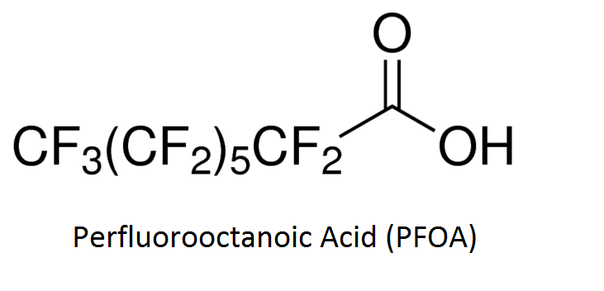
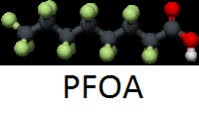

Research Concerns and Considerations
Per- and polyfluoroalkyl substances (PFAS)
Large group of chemicals with many subgroups
Man-made highly fluorinated alkyl (C2-C16) chemicals with unique properties
Hydrophobic and Lipophobic
High affinity for proteins
No natural counterparts
Notes:
“The global regulatory community is specifically interested in ‘‘long-chain’’ perfluoroalkyl sulfonic acids (C_{n}F_{2n+1}SO3H, n> or =6, PFSAs) and perfluoroalkyl carboxylic acids (CnF2n+1COOH, n> or =7, PFCAs) and their corresponding anions (USEPA 2009; OECD 2011), which have been shown to be more bioaccumulative than their short-chain analogues. PFOS and PFOA are the 2 ‘‘long-chain’’ perfluoroalkyl acids most often reported and discussed in the scientific literature.”
PFOS – perfluorooctane sulfonic Acid, perfluorooctane sulfonate, CF₃(CF₂)₇SO₂OH
PFOA – perfluorooctanoic Acid, perfluorooctanoate, CF₃(CF₂)₆COOH

Slide 7

Research Concerns and Considerations
Lowers surface tension and enhances spreading
High chemical and thermal stability (C-F bonds)
Very useful compounds
  Stain-resistant carpets and fabrics
  Food cartons, containers, wrappers
  Surfactants and lubricants
  Aqueous film-forming foams (AFFFs)
  Flame retardants
Notes:
All the above properties makes this myriad of compounds very useful in commerce and ultimately very widely distributed around the world.

Slide 8

Research Concerns and Considerations
Two production methods that yield different products:
  Electro-chemical fluorination (ECF)
    Electrolysis of organic compound in HF
    Breaking and branching of C-chain
    ~70% linear/30% branched in PFOA/PFOS synthesis
  Telomerization
    Multiple step reaction
    PFEI – PFAI – FTI – FTOH – variety of PFAS products
    Linear reactants yield linear alkyl chain products
Perfluoroalkyl acids (PFAAs) are the metabolites of many PFAS precursors
PFAS-based products can be complex mixtures containing the intended end-product, unreacted raw materials or intermediate chemicals, and unintended byproducts.
Notes:
PFEI – Pentafluoroethyl iodine, PFAI – perfluoroalkyl iodine (Telmer A), FTI – fluorotelmer iodine (Telmer B), FTOH – fluorotelmer alcohol
Acrylates are the salts, esters, and conjugate bases of acrylic acid (CH₂=CHCOOH)and its derivatives.
Urethane: 1. A colorless or white crystalline compound, CH₃CH₂OC(O)NH₂, used in organic synthesis and formerly as a palliative treatment for leukemia. Also called ethyl carbamate. 2. Any of several esters, other than the ethyl ester, of carbamic acid (H₂NCOOH).
Stearates are the salts and esters of stearic acid (CH₃(CH2)₁₆COOH). The conjugate base of stearic acid, C₁₇H₃₅COO⁻, is also known as the stearate anion.
The structure of a fluorotelomer alcohol is most commonly F(CF₂)_{n}CH₂CH₂OH, where n is an even number.
PFAS chemicals such as the ammonium salt of hexafluoropropylene oxide–dimer acid (GenX) and other perfluoroalkyl ether acids (PFEA) are receiving increased scrutiny as chemical manufactures use them as replacements for PFOA and other long-chain PFAS (Hopkins et al. 2018, Brandsma et al. 2018).

Slide 9

Research Concerns and Considerations
As acids and esters, PFAS compounds susceptible to ionization/dissociation and increased mobility
Ionized forms likely to predominate in the environment and biota (including humans)
Some PFAS compounds may degrade in the environment or biota, but will ultimately transform to very stable and persistent perfluoroalkyl acids (PFAAs)
The yield rate of PFAAs from biotic and abiotic degradation depends on the precursors and degradation conditions
Increasing C-chain length reduces leachability and increases bioaccumulation
Increasing use and production of alternatives to PFOA and PFOS
Notes:
Acid dissociation (acetic/ethanoic acid) CH3-COOH
Ester, R-COO-R’
Ionized form likely to predominate at the pH for most farming operations
PFOA and PFOS are alkyl acids
PFAS chemicals such as the ammonium salt of hexafluoropropylene oxide–dimer acid (GenX) and other perfluoroalkyl ether acids (PFEA) are receiving increased scrutiny as chemical manufactures use them as replacements for PFOA and other long-chain PFAS (Hopkins et al. 2018, Brandsma et al. 2018).

Slide 10
Research Concerns and Considerations
Buck et al. 2011. Perfluoroalkyl and Polyfluoroalkyl Substances in the Environment: Terminology, Classification, and Origins.
Large number of chemical groups and individual chemicals (>3000 used on the global market)
Similar properties valuable in commerce
Variable behavior in the environment
PFAS products may contain multiple isomers of the intended ingredients, residual intermediary compounds, byproducts, and – after release –degradation products.
Notes:
Buck et al., 2011 is an excellent reference to start to get a handle on PFAS and the scope of the problem.
Many chemical groups and individual compounds that have similar properties in commerce, but behave differently in the environment and have different potential health impacts
This problem is compounded by products with multiple (branched) isomers, residual intermediary compounds, byproducts, and degradation products and new products such side-chain fluorinated polymer surfactants

Slide 11
PFAS and Wastewater Treatment
Pervasiveness and persistence of PFAS in commerce and the environment ensure PFAS loading to WWTFs over the long-term
Across facilities, influent PFAS loading can be variable both in composition and concentration.
Historically PFOA and PFOS the most abundant, typically 5-50 ng/L (Margot et al. 2015, Hamid and Li 2016)
Total concentrations for common PFAS typically 30-150 ng/L (Margot et al. 2015)
A survey of 19 Australian WWTFs, the average total PFAS concentration found in wastewater for 21 chemicals from four different classes of PFAS compounds was 110 ng/L (Coggan et al. 2019)
One study involving an industrial user found influent concentrations of 470 ng/L, 640 ng/L and 61,205 ng/L for PFOS, PFOA, and Perfluorooctanesulfonamide (PFOSA), respectively (Koch, 2015)

Slide 12
PFAS and Wastewater Treatment
Negligible treatment by conventional wastewater treatment, <5% removal (Hamid and Li 2016, Koch, 2015)
Most removal via sorption to wastewater solids
Organic matter partitioning process (Zareitalabad et al. 2013)
Longer carbon-chain (>6 C) tend to adsorb to solids and are removed in the sludge (Koch, 2015)
Effluent PFAS concentrations slightly lower than influent
Precursor degradation can increase effluent PFAA concentrations over influent levels (Clarke and Smith 2011, Hamid and Li 2016, Coggan et al. 2019)
Study | PFOA (ng/L) | PFOS (ng/L)
Margot et al. 2015 | 13 | 12
Zareitalabad et al. 2013 | 24 | 13
Notes:
Anaerobic digestion doesn’t seem to provide much either.
PFAA acid concentrations have been observed to increase during sludge processing and treatment

Slide 13

PFAS in Sewage Sludge
PFAS is present in residuals
  Variable compounds
  Variable concentrations
Highest concentrations are found in residuals with direct industrial input (Lindstrom et al., 2011):
4 WWTF Decatur, AL
  PFOA (ng/g): <17 244
  PFOS (ng/g): 58-159 3000
  PFOSA (ng/g): <44 244
PFAS are also found in residuals without industrial input, but at lower concentrations.
This Photo by Unknown Author is licensed under CC BY-SA
Notes:
PFOSA – Perfluorooctane sulfonamide, CF₃(CF₂)₇SO₂NH₂
Sludge data from Lindstrom et al., 2011, p. 5 – describes study by 3M Company looking at Decateur sludge and other facilities
One facet of the larger question concerns the types and levels of PFAS in residuals. 19 different compounds tabulated from literature and NEBRA results
Residuals with obvious industrial contributions have the highest concentrations.
PFAS is also found in residuals without industrial discharges, but generally at lower levels

Slide 14
PFAS in Sewage Sludge
In the 2000s, PFAS were found in typical biosolids in concentrations of tens of parts per billion (ppb), with a U. S. average of 34 ppb for PFOA and 403 ppb for PFOS (Venkatesan and Halden, 2013).
Studies over time seem to show decreasing concentrations of PFOA and PFOS in residuals while increasing concentrations of alternative PFAS compounds
Other studies have concluded that, at least for the time frame from 2001 to 2007, there was no statistically significant changes in PFOS or overall PFAS concentrations in sludge (Venkatesan & Halden, 2013; Sepulvado et al. 2011)
Degradation and transformation of more complex molecules may explain the continued presence and stable concentrations of PFOA, PFOS, and other PFAA in wastewater residuals and other environmental media even as the use of PFOA, PFOS, and other PFAA is discontinued (Hamid and Li, 2016)

Slide 15
PFAS in Sewage Sludge: PFOA and PFOS Concentrations Over Time
Study | Year(s) of Testing | PFOA (ng/g) | PFOS (ng/g) | Data Type
Lindstrom et al. 2011 | 1999-2001 | 244 | 3000 | single data point
Venkatesan & Halden 2013 | 2001 | 34 | 403 | average
Clarke & Smith 2011 | 2001-2008 | 37 | 196 | median
Sepulvado et al. 2011 | 2004-2007 | 8-68 | 80-219 | range
Gottschall et al. 2016 | 2009 | 1.6 | 7.2 | single data point
Zareitalabad et al. 2013 | 2013 | 37 | 69 | median
NEBRA/DES Data | 2017 | 6.7 | 34 | average
Coggan et al. 2019 | 2017 | 2.6 | 14 | average

Slide 16
PFAS in Sewage Sludge: PFAS Concentrations Changes Over Time
Compound | Venkatesan & Halden 2013 ng/g (2001 averages) | Gottschall et al. 2016 ng/g (2009 data point) | NEBRA/DES Data ng/g (2017 averages)
PFBA | 2 | <0.4 | 34.6
PFPeA | 3.5 | 1.2 | 22.5
PFHxA | 6.2 | 1.5 | 11.0
PFHpA | 3.4 | <0.4 | 1.1
PFOA | 34 | 1.6 | 6.7
PFNA | 9.2 | 19 | 2.6
PFBS | 3.4 | 22 | 5.7
PFHxS | 5.9 | <0.7 | 13.3
PFOS | 403 | 7.2 | 34

Slide 17
PFAS in Sewage Sludge
2017 PFAS data compiled by NHDES and NEBRA,
22 facilities from NH and Northeast, 27 data points
Chemical | % detection | Conc. Range (ug/Kg) | Ave. Conc. (ug/Kg)
PFBA | 20 | 0.54 – 140 | 34.6
PFPeA | 8 | 18 – 27 | 22.5
PFHxA | 84 | 0.21 – 75 | 11.0
PFHpA | 26 | 0.077 – 2.8 | 1.1
PFOA | 32 | 1.1 – 15 | 6.7
PFNA | 30 | 1 – 3.6 | 2.6
PFBS | 7 | 5.2 – 6.2 | 5.7
PFHxS | 22 | 0.24 – 73 | 13.3
PFOS | 62 | 0.59 - 390 | 34

Slide 18
Land Application of Residuals and Soil Impacts
Land application of PFAS contaminated residuals results in detectable PFAS concentrations in the soil.
Soil concentrations following land application reported in the literature:
Source | Type of loading | PFOS (ug/Kg) | PFOA (ug/Kg)
Washington et al., 2009 | High PFAS | 30 – 410 | 50 – 320
Sepulvado et al., 2011 | Short-term Long-term | 2 – 11 5.5 – 483 | No data
Gottschall et al., 2017 | One-time | 0.2 – 0.4 | 0.1 – 0.8
Zareitalabad et al., 2013 | Background Conc. | 0.124 | 0.472
Rankin et al. 2016 | High Background | 2.67 | 3.1
Notes:
Washington et al. is the data for the Decatur, Al site which was high PFAS biosolids applied for up to 12 years.
Sepulvado et al, - long-term sites were applies for up to 32 years at high loads (100 yrs. of agronomic loading in 32 years), short-term sites were applied for 3 years at loading of up to 133 Mg/ha (~60 dry T/A).
Gottschall et al. was a one-time application of 22 Mg/ha (~10 dry T/A)
The data from Zareitalabad et al. (2013) are for background soil concentrations derived from limited data from around the world.
Rankin et al. data includes 62 surface soil samples from all continents. PFOA and PFOS were the most commonly detected analytes at concentrations up to 2670 (2.67 ppb) and 3100 pg/g (3.1) ppb, respectively. These soils were collected from locations absent of direct human activity.

Slide 19
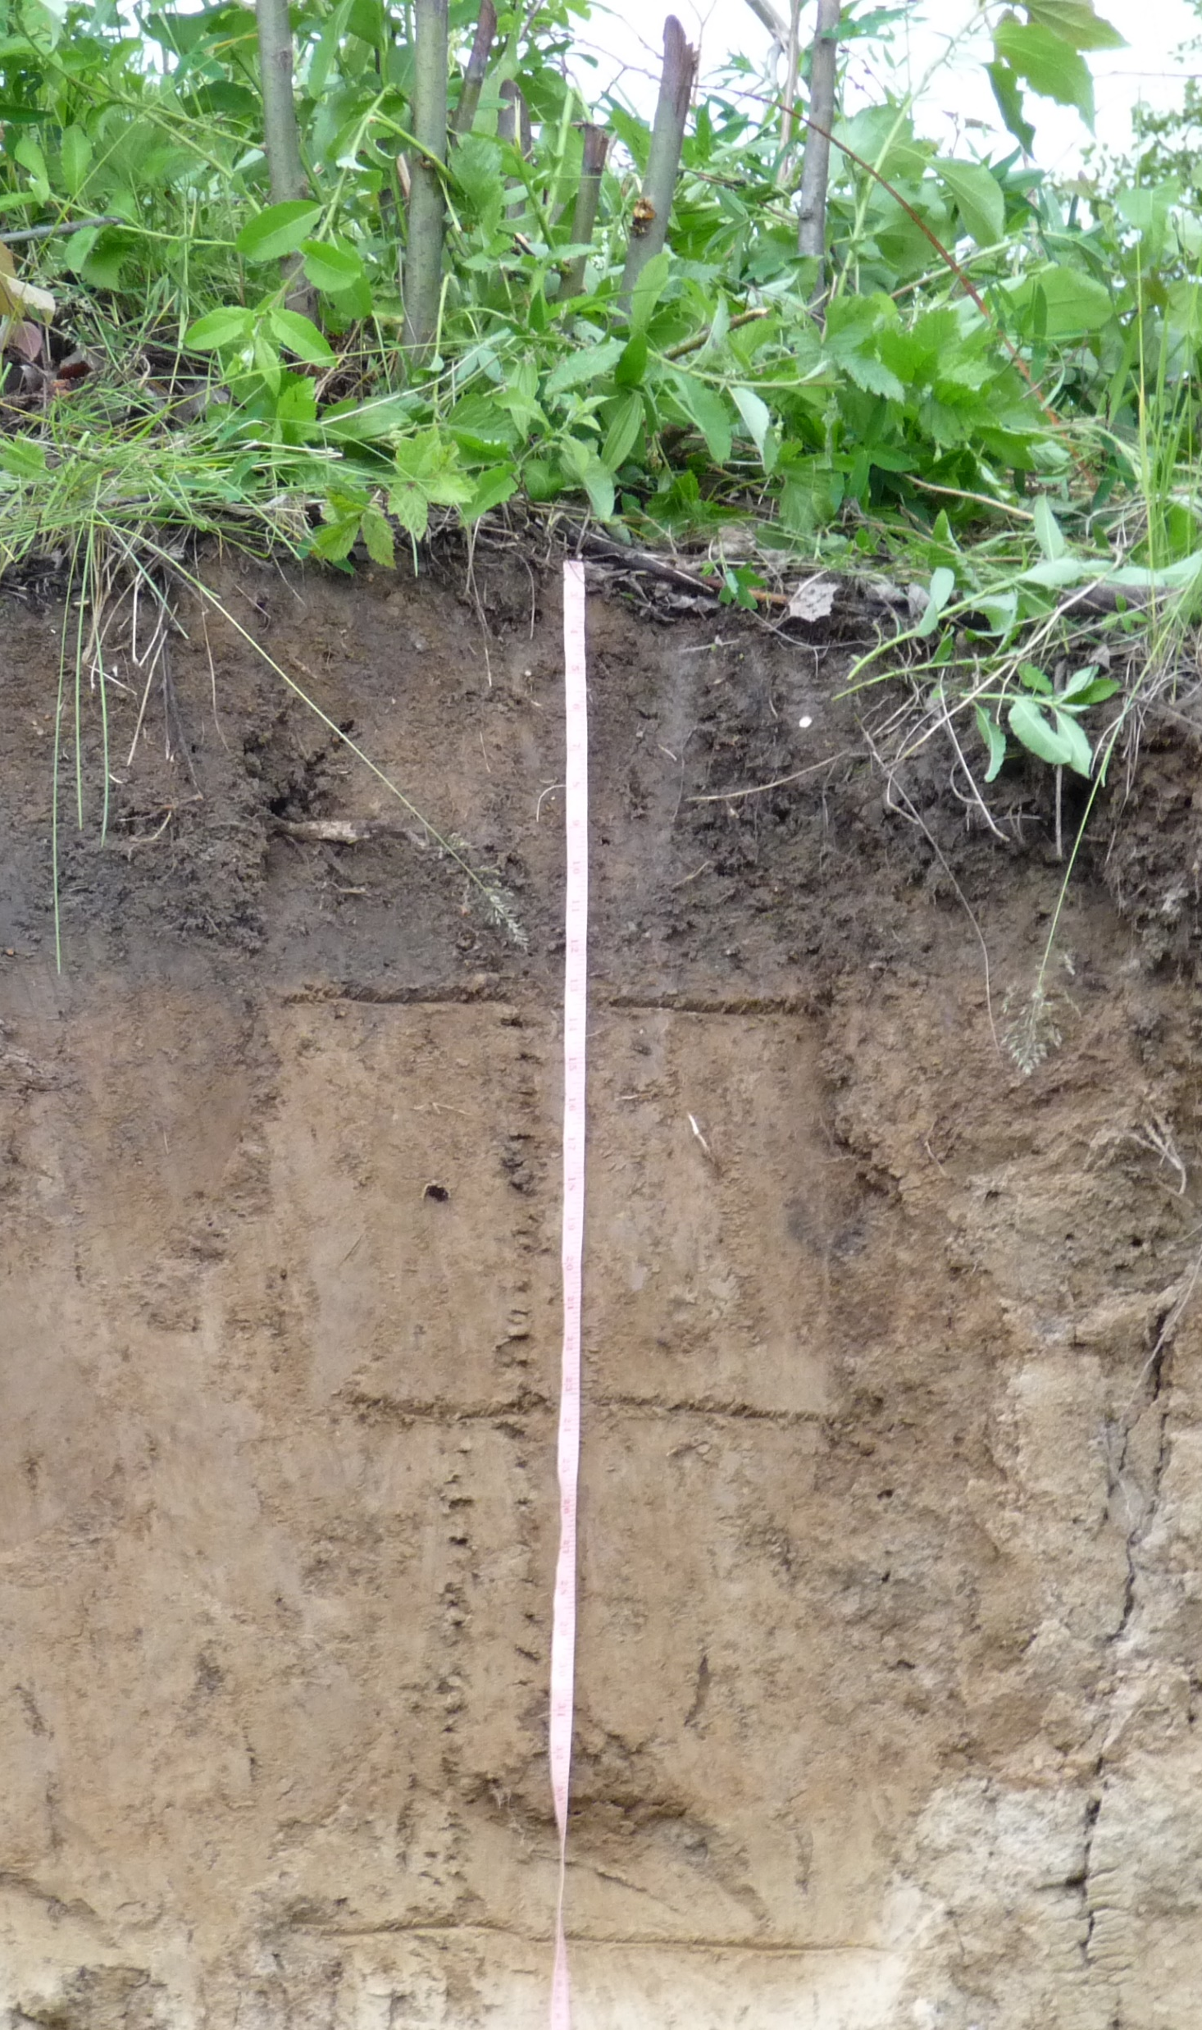
Land Application of Residuals and Soil Impacts
PFAS soil concentrations can be correlated to residuals loading rate (Sepulvado et al. 2011; Lindstrom et al. 2011)
Correlation is especially strong for longer chain (>C8) PFCA.
For short chain PFCA, soil concentration may correlate better with time from last application.
PFAS concentrations in well water and surface water can be correlated to loading rate of short chain PFAS.
Soil PFAS concentrations at depth may increase over time.
Soil PFAS concentration can change as a result of precursor degradation.
This Photo by Unknown Author is licensed under CC BY-SA

Slide 20
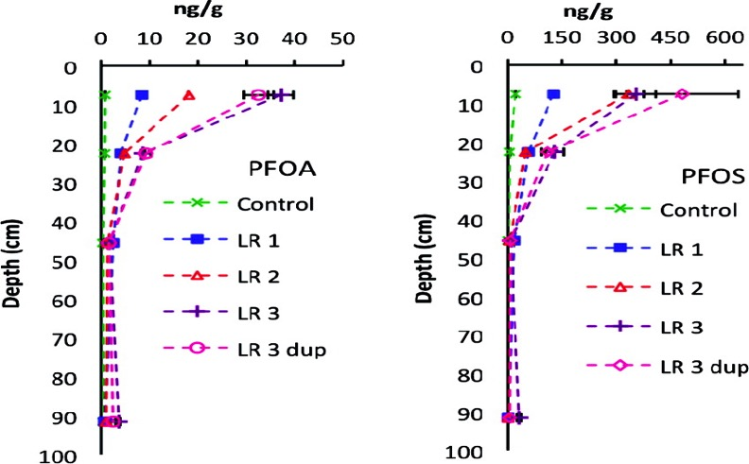
Land Application of Residuals and Soil Impacts
Sepulvado et al; Environ. Sci. Technol. 2011, 45, 8106-8112
Concentrations of PFOA Concentrations of PFOA and PFOS with depth in the long-term plots at various loading rates.
Control = 0 Mg/ha
LR1 = 553 Mg/ha
LR 2 = 1109 Mg/ha
LR 3 and LR 3 dup = 2218 Mg/ha (dry weight basis).
tConcentrations of PFOA and PFOS with depth in the long-term plots at various loading rates.
Control = 0 Mg/ha, LR 1 = 553 Mg/ha, LR 2 = 1109
.

Slide 21
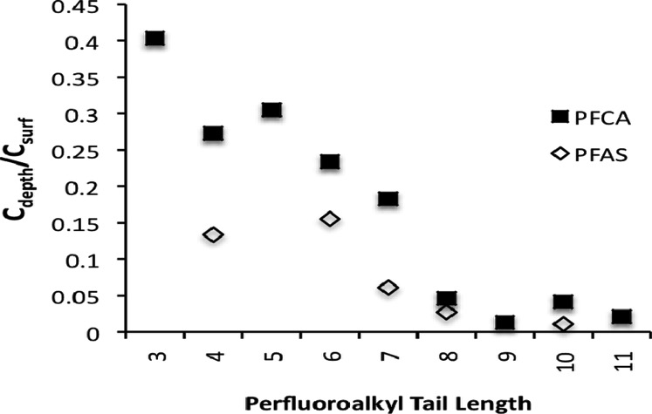
Mobility varies with chemical structure
Sepulvado et al; Environ. Sci. Technol. 2011, 45, 8106-8112
Ratios of surface concentration (Csurf) to concentration in the bottom soil core depth interval (60−120 cm, Cdepth).
Ratios represent an average of the ratios calculated for the long-term plots for each biosolids loading rate.
epth interval (60−120 cm, Cdepth).
Ratios represeRatios of surface concentration
.

Slide 22

PFAS Risk and Wastewater Residuals (Mobility/Leaching)
Little direct evidence that residuals without obvious industrial PFAS contributions are a risk to public health via groundwater contamination following land application
A determination of public health risk is influenced by several factors:
  Type and quality of wastewater residuals,
  PFAS compounds to be considered,
  Field conditions (OM content, climate, soil type, depth to groundwater, etc.), and
  Regulatory requirements (loading limits, land application restriction, drinking water standards, required setback, application rates).
Differences in these factors from state to state can lead to different conclusions regarding public health risk

Slide 23
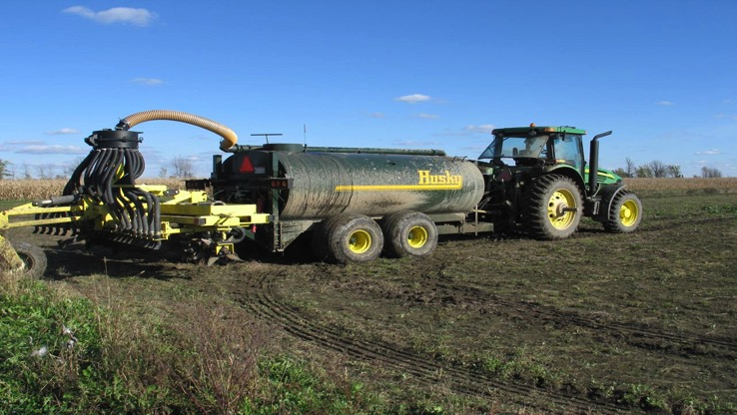
Mobility in the Soil and Risk to Groundwater
Study site in Ontario:
Humid continental climate
Corn, wheat, soy rotations
Very light tillage
Systematic tiling, 15m spacing, about 1m depth
Ottawa biosolids (mixed residential, industrial, commercial):
1.6 ug/kg PFOA, 7.2 ug/kg PFOS
Treated by AD, centrifugation
22 Mg dw/ha (9.8 tons dw/ac)
Moldboard plow to ~ 20cm
Planted to winter wheat
Gottschall et. al. 2017. Sci. Total Environ. 574: 1345 – 1359
Notes:
Biosolids:
[PFOA] = 1.6 ug/kg, [PFOS] = 7.2 ug/kg
Anaerobically digested
applied at 22 Mg/ha dry weight
Plowed to a depth of ~20 cm (~8 inches)

Slide 24
Conclusions (Gottschall et al. 2017)
Perfluorinated chemicals detected in both groundwater and tile discharge after a single large biosolids application.
For groundwater concentrations, there was no statistically significant difference between control and treatment plots.
Highest 2m groundwater concentrations:
  PFOA: bd - 3 ng/L
  PFOS: bd – 0.8 ng/L
Chemicals detected for months after the application.
Relative contributions of leaching through soil matrix, and preferential flow through macropores are unknown.
No groundwater standards or guidelines exceeded
No PFAS in wheat grain samples
shallow groundwater
tile discharge
Gottschall et. al. 2017. Sci. Total Environ. 574: 1345 – 1359
Notes:
However, PFAS was detected in groundwater before biosolids applications and the concentrations of PFAS were not statistically different between control and treatment plots.
Post application drainage tile concentrations were significantly (statistically) higher in the treatment plot.

Slide 25
Mobility in the Soil and Risk to Groundwater
What does the scientific literature tell us about leachability of PFAS:
PFAS can and does move through the vadose zone to groundwater
Correlations between biosolids/PFAS loading and observed groundwater and surface water concentrations have been observed
One potential set of conservative soil screening levels for protection of groundwater were calculated for PFOS (3 ug/kg) and PFOA (3 ug/kg) (Xiao et al. 2015)
Observation in groundwater can follow release to surface soils by years if not decades, especially for longer chain PFAS (C8 and higher)
Notes:
Modeling performed by Stone Environmental in Vermont under a contract from NEBRA calculated that biosolids concentrations could in fact be higher even while using some relatively conservation modeling assumption (Kd, depth to groundwater)

Slide 26
Mobility in the Soil and Risk to Groundwater
Sorption in the soil does occur and is best described as a complex sorption equilibrium reaction
PFAS sorption equilibria (log K_{d})are influenced by:
  PFAS carbon chain length
  Organic carbon content and type
  pH
  Cation concentrations
  Specific surface area/clay content
  Types of soil minerals
Notes:
Soil adsorption coefficient (Kd) measures the amount of chemical substance adsorbed onto soil per amount of water.
Kd = Concentration of chemical in soil/Concentration of chemical substance in water
Values for Kd vary greatly because the organic content of soil is not considered in the equation. Since adsorption occurs predominantly by partition into the soil organic matter, it is more useful to express the distribution coefficient in Koc. Koc is also known as organic carbon-water partition co-efficient.
Koc = (Kd * 100)/ % Organic carbon
Koc is also frequently estimated based on octanol-water partition coefficient Kow and water solubility.
Kd or Koc measures the mobility of a substance in soil. A very high value means it is strongly adsorbed onto soil and organic matter and does not move throughout the soil. A very low value means it is highly mobile in soil. Koc is a very important input parameter for estimating environmental distribution and environmental exposure level of a chemical substance.
Increasing pH, especially in the 6-8 range can decrease sorption and increase mobility.
Increasing cation concentrations in soil solution can decrease sorption to the mineral fraction, but can increase sorption to organic matter.

Slide 27
Human PFAS Exposure Resulting from Plant and Animal Uptake from Soils Amended with Wastewater Residuals
Controlling factors for plant uptake:
PFAS concentrations in the soil,
PFAS chain length and functional groups,
Plant species/organ, and
Soil organic matter content.
Notes:
Plant uptake shows an inverse relationship with carbon chain length, with a statistically significant correlation between decreasing bioaccumulation factors and increasing carbon chain length (Blaine et al. 2014; Blaine et al. 2014A; Blaine et al. 2013, Gobelius 2016, Liu et al. 2019). For PFOA and PFOS, PFAS bioaccumulation appears to decrease with translocation through the plant from roots to shoots to fruit/plant storage organs (Stahl et al. 2008; Blaine et al. 2014; Blaine et al. 2013; Wen et al. 2016). The highest concentrations of long-chain (>C6) PFAS are usually found in the roots while short-chain (C4-C6) are more likely to accumulate in above-ground plant organs (Navarro et al. 2017, Ghisi et al. 2018).
It appears the PFCAs (e.g. PFOA) have a higher potential to bioaccumulate than perfluoroalkyl sulfonic acids (e.g. PFOS) (Stahl et al. 2008; Blaine et al. 2014A; Wen et al. 2016; Perez et al. 2017, Gobelius 2016, Liu et al. 2019).
Numerous studies have shown plant uptake of PFAS is variable across plant species as well as plant organs within the same species (Stahl et al. 2008; Blaine et al. 2014, Blaine et al. 2014A; Blaine et al. 2013; Wen et al. 2016).

Slide 28
Human PFAS Exposure Resulting from Plant and Animal Uptake from Soils Amended with Wastewater Residuals
Carbon-chain length and functional groups are significant factors controlling accumulation and elimination (route and rate) of PFAS from animal tissue
  Longer C-chain and sulfonate functional groups favor retention
  Shorter C-chain and carboxylate functional groups favor faster elimination
Unlike other organic contaminants PFAS doesn’t accumulate in fatty tissue
Generally, liver, kidneys, and blood plasma tend to accumulate higher PFAS concentrations than muscle tissue
Consumption of plant and animal products can be a source of PFAS in the human diet
There is little evidence that PFAS in the human diet is a significant public health concern (Lupton et al. 2011; Kowalczyk et al. 2013; Blaine et al. 2014; Perez et al. 2017)
Limited use of residuals and harvesting restriction make it unlikely land application will increase PFAS risk

Slide 29
Conclusions
Conclusions on PFAS risk:
The ubiquitous presence of PFAS in plant, animal, and human tissue as well as air, soil, and water resources confirms the obvious mobility of these chemicals
However, there is little information to answer our original question
Need research on long-term land application sites to answer questions about PFAS risk
A little perspective on PFAS risk from wastewater residuals:
  PFAS are in residuals because they have been widely used for decades and persistent in the environment
  Presence in residuals is not evidence of risk or even significant exposure in excess of current everyday exposure
  Uncertainty on extent of public health risk

Slide 30
References
Analyzing PFAS in Wastewater, Solids, & Soils: State of the Science Webinar, NEBRA Webinar, Sept. 14, 2017
Blaine, A., Rich, C., Sedlacko, E., Hundal, L., Kumar, K., Lau, C., Mills, M., Harris, K., and Higgins, P., 2014. Perfluoroalkyl acid distribution in various plant compartments of edible crops grown in biosolids-amended soils. Environmental Science & Technology, (2014) 48, 7858–7865.
Boone, J.S., Vigo, C., Boone, T., Byrne, C. Ferrario, J., Benson, R., Donohue, J., Jane Ellen Simmons, J.E., Kolpin, D.W., Furlong, E.T., and Glassmeyer, S.T., 2018. Per- and polyfluoroalkyl substances in source and treated drinking waters of the United States. Science of the Total Environment, (2019) 653, 359–369.
Buck, R., Franklin, J., Berger, U., Conder, Cousins, I., de Voogt, P., Jensen, A., Kannan, K., Mabury, S., van Leeuwenkket, S., 2011. Perfluoroalkyl and Polyfluoroalkyl Substances in the Environment: Terminology, Classification, and Origins. Integrated Environmental Assessment and Management, Vol. 7, No. 4, 513–541.
Coggan, T.L., Moodie, D., Kolobaric, A., Szabo, D., Shimeta, J., Crosbie, N.D., Lee, E., Fernandes, M., and Clarke, B.O., 2019. An investigation into per- and polyfluoroalkyl substances (PFAS) in nineteen Australian wastewater treatment plants (WWTPs). Heliyon, (2019) 5, e02316.
Gottschall, N., Topp, E., Edwards, M., Payne, M., Kleywegt, S., Lapena, D.R., 2017. Brominated flame retardants and perfluoroalkyl acids in groundwater, tile drainage, soil, and crop grain following a high application of municipal biosolids to a field. Science of the Total Environment, 574, 1345–1359.

Slide 31
References
Hamid, H. and Li, L.Y., 2016. Role of wastewater treatment plant in environmental cycling of poly- and perfluoroalkyl substances. Ecocycles: Scientific Journal of European Ecocycles Society, (2016), 2(2) 43-53.
Koch, A., 2015. Fate of pharmaceuticals and perfluoroalkyl substances during source separated wasterwater treatment. Swedish University of Agricultural Sciences, Dept. of Aquatic Sciences and Assessment, Master's thesis
Kowalczyk, J., Ehlers, S., Oberhausen, A., Tischer, M., Furst, P., Schafft, H., and Monika Lahrssen-Wiederholt, M., 2013. Absorption, Distribution, and Milk Secretion of the Perfluoroalkyl Acids PFBS, PFHxS, PFOS and PFOA by Dairy Cows Fed Naturally Contaminated Feed. Journal ofAgricultural and Food Chemistry, (2013) 61, 2903−2912.
Lindstrom, A., Strynar, M., Delinsky, A., Nakayama, S., McMillan, L., Libelo, L., Neill, M., Thomas, L., 2011. Application of WWTP Biosolids and Resulting Perfluorinated Compound Contamination of Surface and Well Water in Decatur, Alabama, USA. Environmental Science & Technology, 45 (19), 8015–8021.
Lupton, S., Huwe, J., Smith, D., Dearfield, K., and Johnston, J., 2011. Absorption and Excretion of 14C-Perfluorooctanoic Acid (PFOA) in Angus Cattle (Bos taurus). Journal of Agricultural and FoodChemistry, (2012) 60, 1128−1134.
Margot, J., Ross, L., Barry, D.A., and Holliger, C., 2015. A review of the fate of micropollutants in wastewater treatment plants. 2015 Wiley Periodicals, Inc., WIREs Water 2015. doi: 10.1002/wat2.1090.

Slide 32
References
Perez, A., Poteete, C., Louie, F., Garner, L., and Scott, P., 2017. State of the science and meta-analysis of crop uptake of per- and polyfluoroalkyl substances (PFAS). Presented at the DIOXIN 2017 Symposium, Vancouver Canada.
Prevedouros, K., Cousins, I.T., Buck, R.C., and Korzeniowski, S.H., 2006. Sources, Fate and Transport of Perfluorocarboxylates. Environmental Science & Technology, Vol. 40, No. 1, 32-44
Rankin, K., Mabury, S.A., Jenkins, T.M., and Washington, J.W., 2016. A North American and global survey of perfluoroalkyl substances in surface soils: Distribution patterns and mode of occurrence. Chemosphere, (2016), 161, 333-341.
Sepulvado, J., Blaine, A., Hundal, L., Higgins, C., 2011. Occurrence and Fate of Perfluorochemicals in Soil Following the Land Application of Municipal Biosolids. Environmental Science and Technology, 45 (19), 8106–8112.
Vedagiri, U.K., Anderson, R.H., Loso, H.M., and Schwach, C.M., 2018. Ambient levels of PFOS and PFOA in multiple environmental media. 2018 Wiley Periodicals, Inc., Remediation, (2018), 28:9–51.
Venkatesan, K, and Halden, R., 2013. National inventory of perfluoroalkyl substances in archived U.S. biosolids from the 2001 EPA National Sewage Sludge Survey. Journal of Hazardous Materials, 252– 253, (2013), 413– 418.
Washington, J., Ellington, J., Hoon, Y., and Jenkins, T., 2009. Results of the Analyses of Surface Soil Samples from Near Decatur, Alabama for Fluorinated Organic Compounds. U.S. EPA, EPA Office of Research and Development

Slide 33
References
Xiao, F., Simcik, M., Halbach, T., Gulliver, J., 2013. Perfluorooctane sulfonate (PFOS) and perfluorooctanoate (PFOA) in soils and groundwater of a U.S. metropolitan area: Migration and implications for human exposure. Water Research, 72 (2015), 64 74.
Xiao, F., Gulliver, J., Simcik, M., 2013. Transport of Perfluorochemicals to Surface and Subsurface Soils. Center for Transportation Studies University of Minnesota, Report No. CTS 13-17.
Zareitalabad, P., Siemens, J., Hamer, M., Amelung, W., 2013. Perfluorooctanoic acid (PFOA) and perfluorooctanesulfonic acid (PFOS) in surface waters, sediments, soils and wastewater – A review on concentrations and distribution coefficients. Chemosphere 91 (2013), 725–732.

Slide 34

QUESTIONS?
Michael Rainey
186 Long Pond Rd.
Northwood, NH 03261
atthepond@metrocast.net
(603) 942-5312
Ned Beecher, Executive Director
NEBRA
Tamworth, NH
ned.beecher@nebiosolids.org
603-323-7654

